Slide 1

Enginius
Resource Allocation
Minder Chen, CSU Channel Islands
Copyright (c) 2022, DecisionPro Inc.
Please refer to under readings for this week:
** tn10_-_resource_allocation_technical_note
** Technical_note_response_models

Slide 2
OFFICESTAR: RESOURCE ALLOCATION
The sole purpose of this data set is to show the basic functionalities of the Resource Allocation model.
In this example, an office-supply company named OfficeStar tries to optimize the various channels (media) used to advertise its stores.

Slide 3
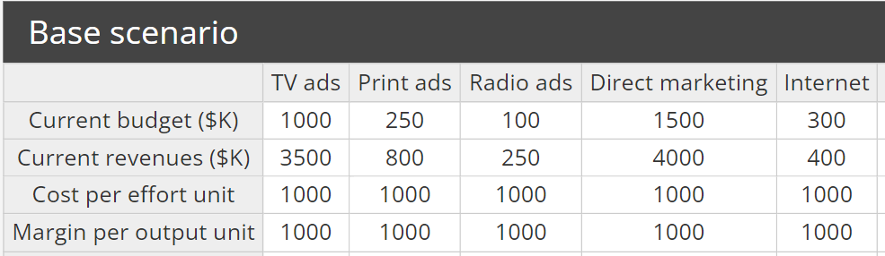
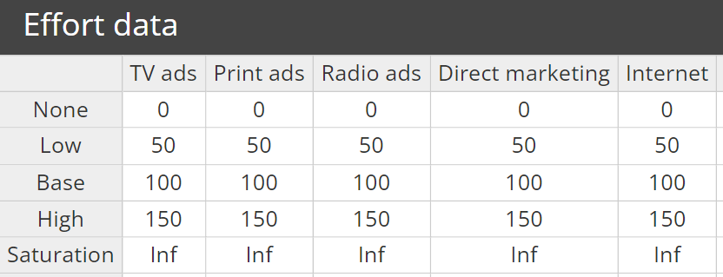


Input Data
Marketing communication (Marcom) mix
*Margin/Cost Ratio
is 1
* Current effort, cost per effort unit (>0), and margin per output unit (can be set to 1) for each category.
* Margin means Revenue here!
* Levels of efforts is the input to the response function

Slide 4
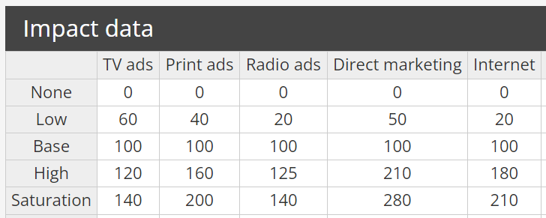
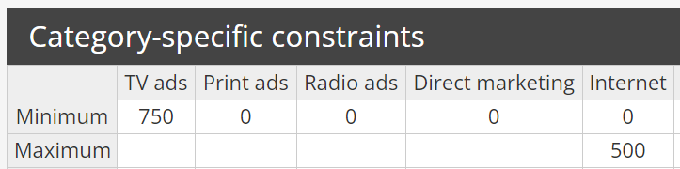


Input Data
These numbers are relative numbers based on experts' opinions used to derived response function and its coefficients
* Estimated impact (the output of the response function) for each corresponding effort level (input), used to calibrate the response functions. ➔ Which media are more effective?
Optional Input Data
* Category-specific constraints. The maximum can be left empty.

Slide 5
Survey Managers Using Delphi Method
Impact Data
Compared sales effort with a base X1 (e.g., 100) at the present levels, what will be the impact/revenue Y1 (e.g., 100)?
No sales effort? X0 ➔ Y0
One-half the current effort? X0.5 ➔ Y0.5
X1 is the base level
50% greater effort? X1.5 ➔ Y1.5
A saturation level of sales effort? X∞ ➔ Y∞
➔ You can set more than 5 levels of sales effort!

Slide 6
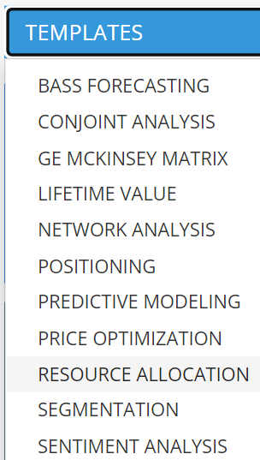
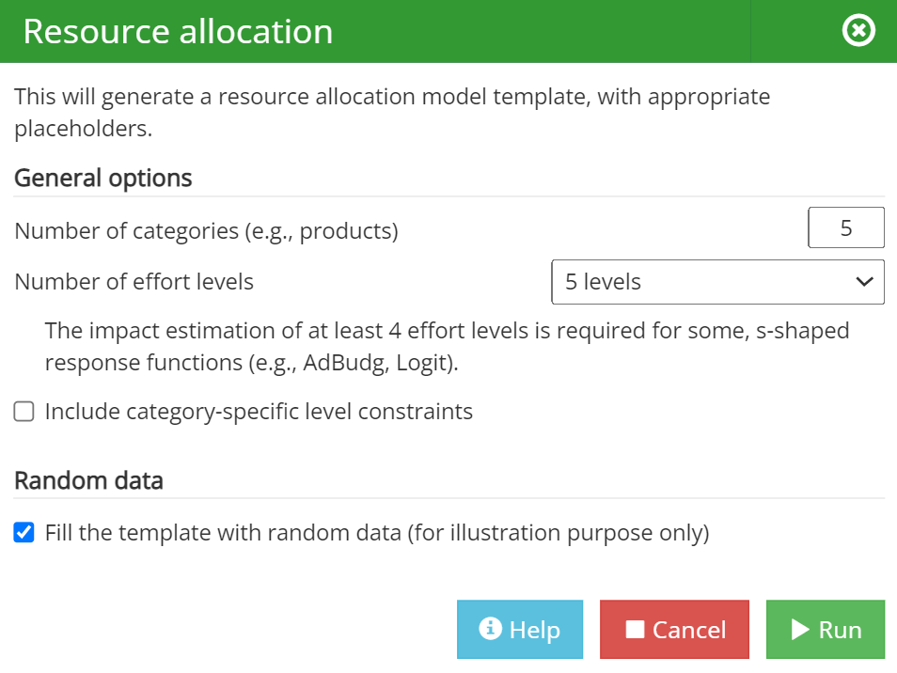
Input Data Templates Generation
Advertising media

Slide 7
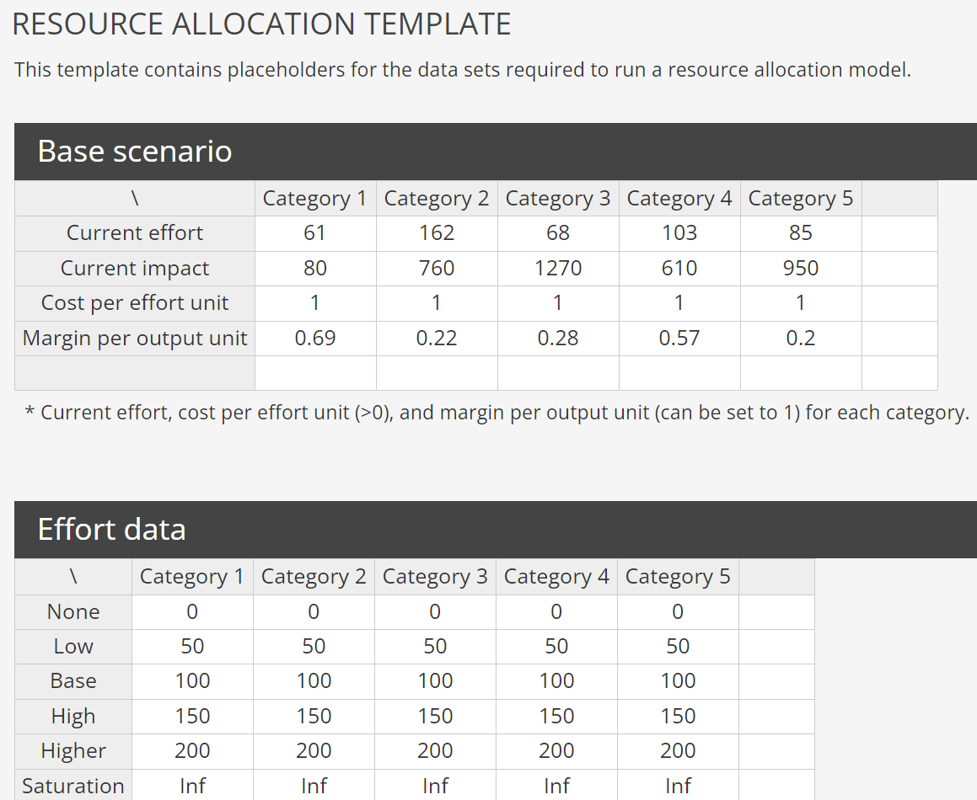
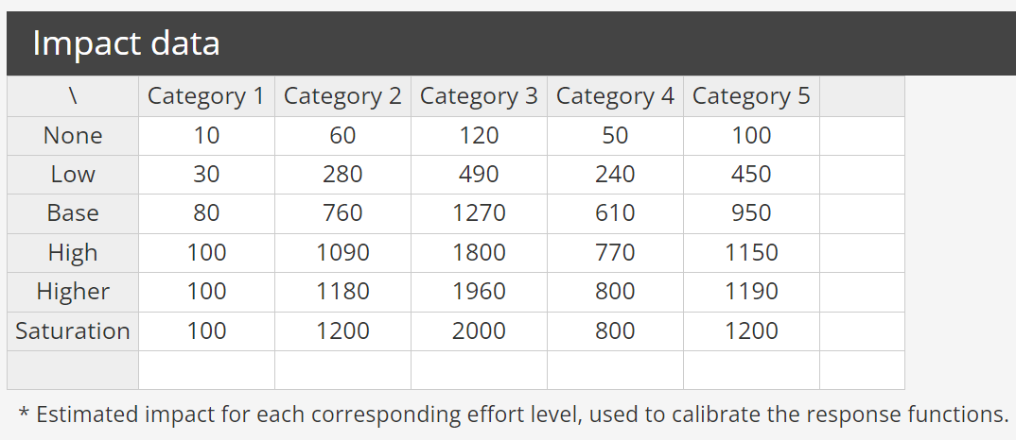
RESOURCE ALLOCATION TEMPLATES
Generated By Enginius
Use Delphi Method to Estimate the Impact at different levels of Effort

Slide 8
Input Data
**Number of categories: A category is the base unit of analysis in resource allocation; you might allocate resources across advertising media, channels, customers, or products, such that each channel, customer, or product is defined by the generic term “categories” for the purposes of this analysis.
Number of effort levels: The calibration of the response curve requires the consensus estimates of how outcomes might be affected by changes in the input variables for each segment. For instance, how much additional sales would be generated by an increase of 50% in the sales force allocated to a specific customer segment or product? Obtaining accurate and consistent consensus estimates from a group of managers and experts is as much an art as it is a science. It requires free information exchange, constructive feedback, and a constructive discussion of the “what-if?” scenarios.
Category-specific level constraints (optional): The number of periods to forecast will be available if either the Advanced Bass model template or the Variable market potential options are selected. Enter the number of periods you want to forecast. Notice that this option simply creates placeholders for anticipated market potential and/or price and advertising levels; it does not generate forecasts.

Slide 9
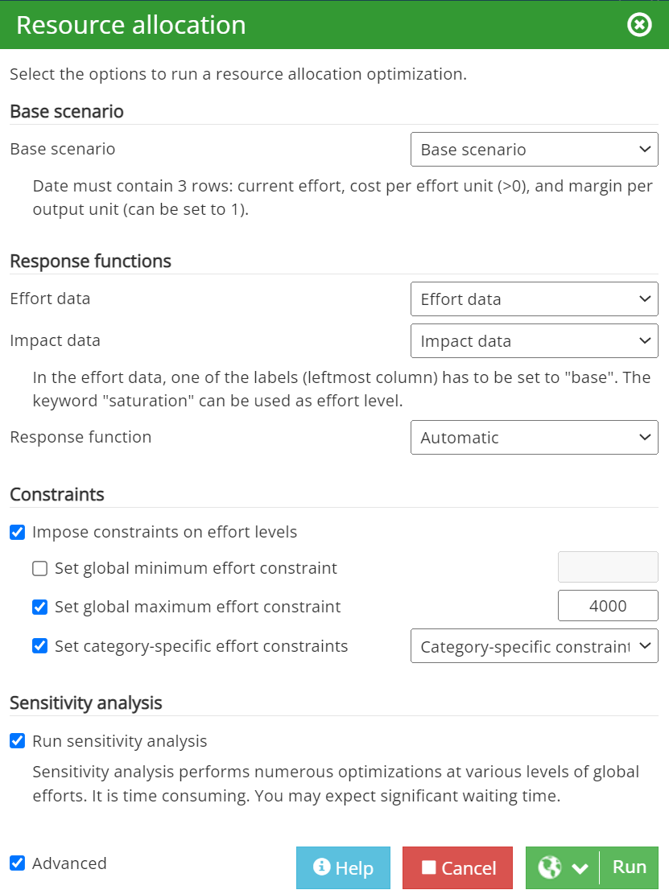
Run the Model
⬅Total costs (budget) allocated across multiple media (categories) and our totak spending cannot be more than this amount
⬅ Set category-specific effort constraints

Slide 10
Resource Allocation
Resource allocation analysis helps firms answer such questions as:
How much should we spend in total during a given planning horizon?
How should that spending get allocated to each marketing mix element? How much of our budget should be spent on advertising and other forms of impersonal marketing communications? On sales promotion? On the sales force?
How should individual budgets be allocated? To customers? To geographies? To subelements of the marketing communications mix? Over time?

Slide 11
Resource Allocation Requirements
Base scenario:
  Select the data block that contains the base scenario (current levels of effort and outcome).
Response functions:
  Select the data blocks that contain the effort data (X) and impact data (Y) over multiple categories to calibrate your response functions.
Constraints:
  Set global minimum effort constraint: The minimum level of effort constraint. Often this will be set to zero to prevent the software from a solution with negative levels of effort.
  Set global maximum effort constraint: The maximum level of effort constraint across all categories.
  Set category-specific effort constraints: Select the data block that contains your category specific constraints.

Slide 12
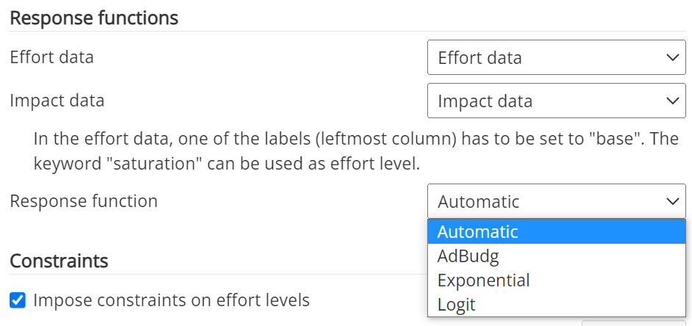
Input Data and Settings for Response

Slide 13
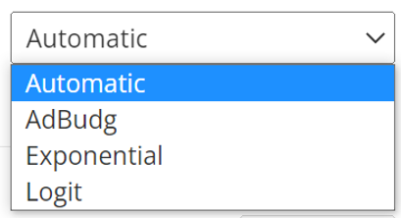
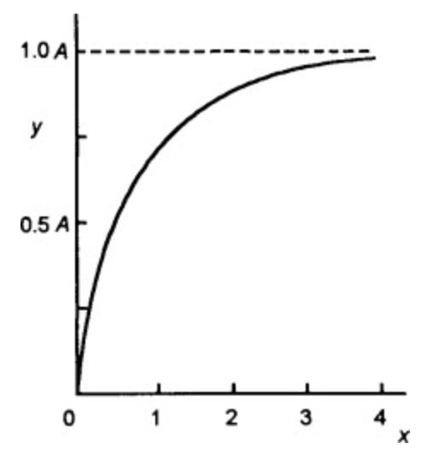
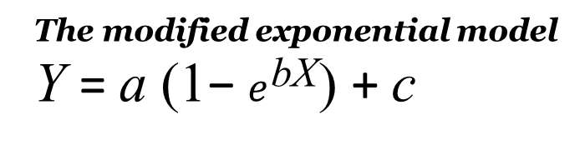
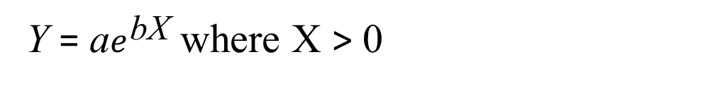
Response Function Model Selection
AdBudg and Logit response functions are S-shaped functions that allow outcomes to increase very slowly as you increase effort from low levels, and then accelerate rapidly, before eventually reaching a plateau, or saturation level.
An Exponential response function increases rapidly at the very beginning, and each additional effort unit has a marginally lower impact than the previous effort unit.
Automatic will select the most appropriate response function for each Category. The response function used for each category will be indicated in the report produced.
Y = a$e^{\text{bX}}$ where X > 0
The modified exponential model
Y = a (1− $e^{\text{bX}}$) + c
a + c
(a + c)/2

Slide 14
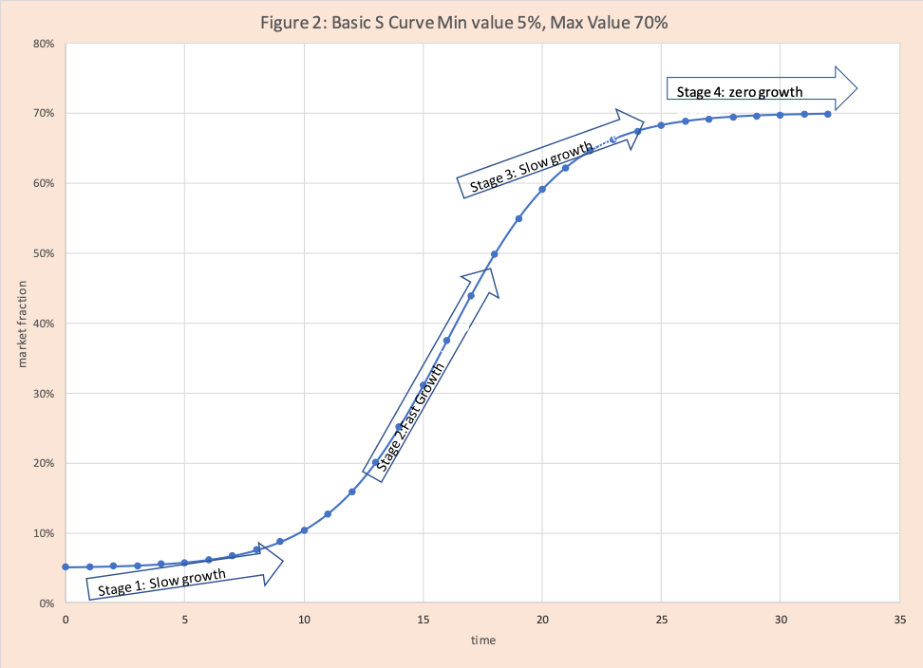
S-Curve
https://blog.arkieva.com/basics-on-s-curves/

Slide 15
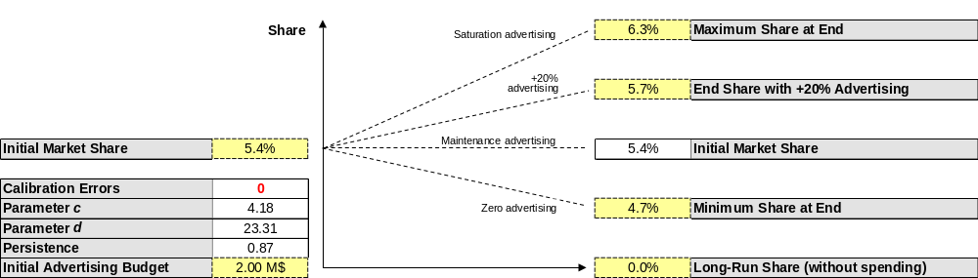

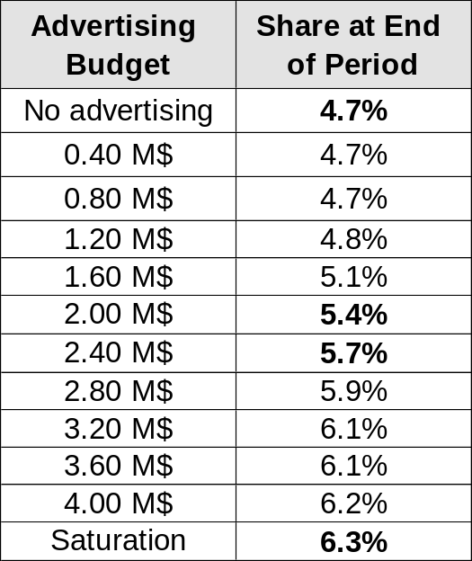
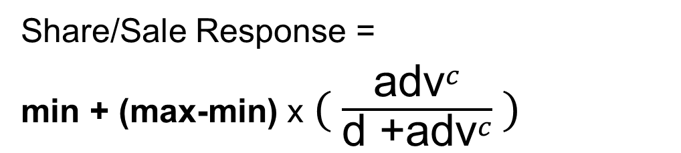
Market share = impacts
①
②
Advertising budget=Efffort
Share/Sale Response =
min + (max-min) x $( \frac{{\text{adv}}^{c}}{\text{d}\text{ +}{\text{adv}}^{c}} )$
④
③
From
blue_mountain_coffee_adbudg.xls

Slide 16
Run sensitivity analysis
Sensitivity analysis performs numerous optimizations at various levels of global efforts.

Slide 17
Interpreting the results
Response function calibration
The report will display the response functions calculated for each category.
Parameters are the constants (usually the a’s and b’s) in the mathematical representation of models. To make a model form apply to a specific situation, we must estimate or guess what these values are; in this way we infuse life into the abstract model. Parameters often have direct marketing interpretations (e.g., market potential or price elasticity).
Calibration is the process of determining appropriate values of the parameters (i.e. coefficients). You might use statistical methods (i.e., linear regression), some sort of judgmental process (e.g., Delphi method), or a combination of approaches.

Slide 18
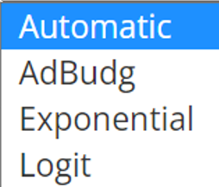
Resource Allocation: Basic Framework
Resources/Efforts
Market Mechanism modeled by Response Functions
Performance/Impacts
Marketing Mix Effort
Impact: Market outcomes
Regression
Tool
Effort
Data
+
Impact
Data
Base Scenario Current effort
Current impact
Cost per effort unit
Margin (Revenue) per output unit
Coefficients of
Response Functions
+
Over multiple categories where resource (budget) will be allocated!
Optimization Tool
(e.g., Excel Solver)
Find
Effort (Advertising Budget) of marketing mix that optimizes net profit!
Use Effort Data & Impact Data to infer the coefficients of response function (model) parameters ➔ Use the model and Base Scenario data to calculate the model fit at different marketing efforts & to find the Optimized effort that optimizes the profit.

Slide 19
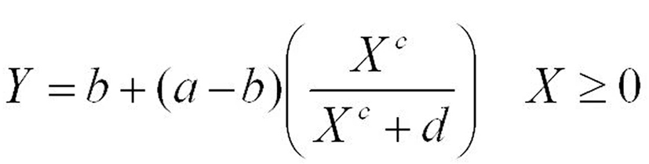
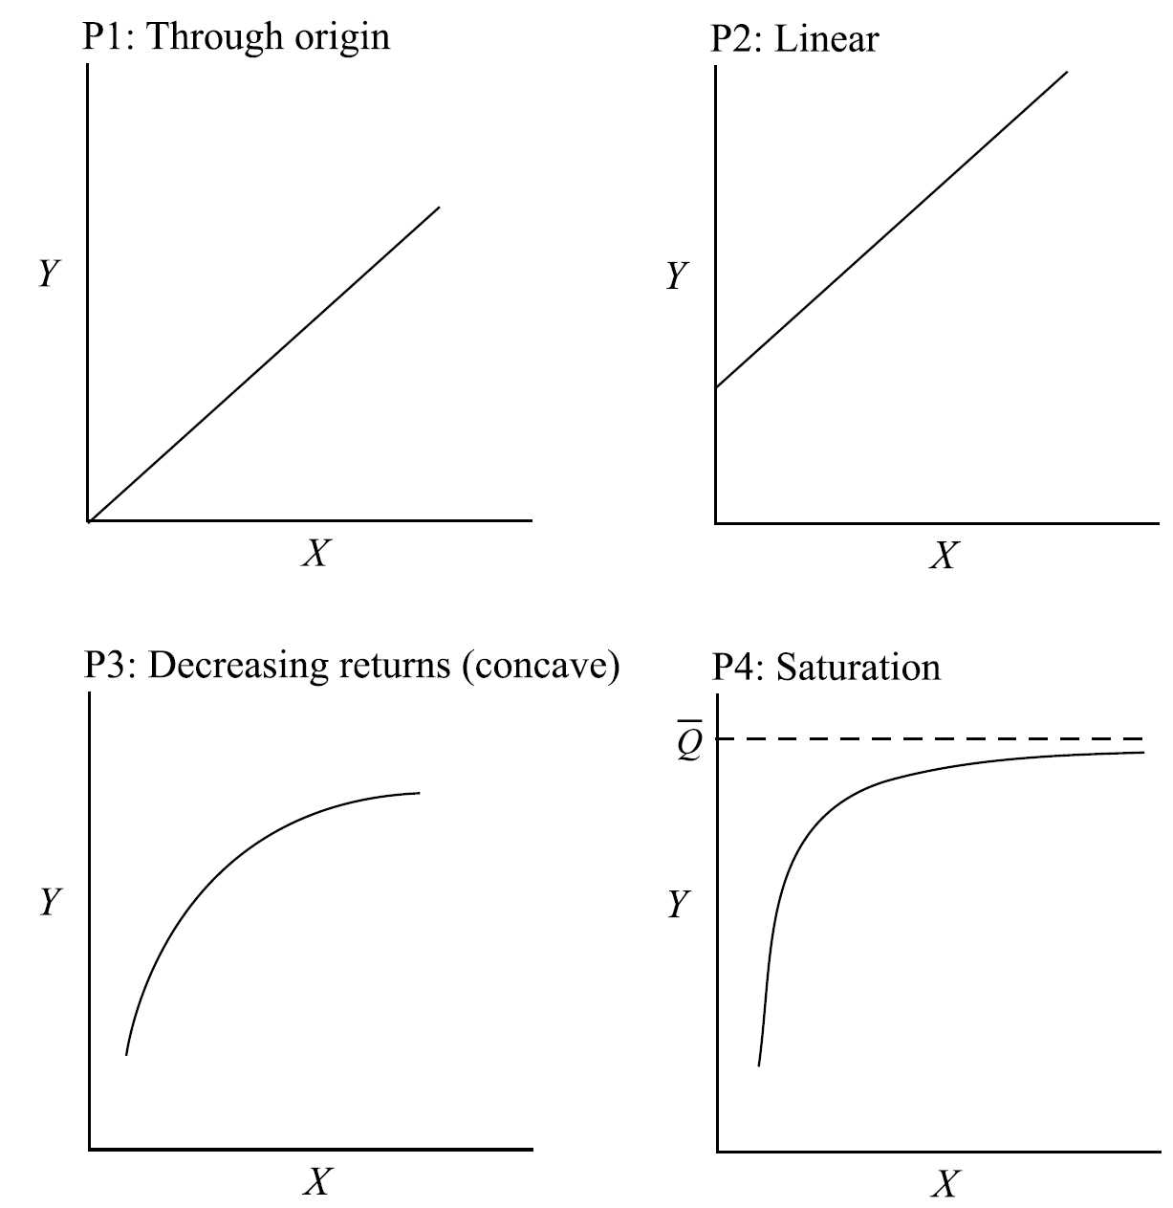
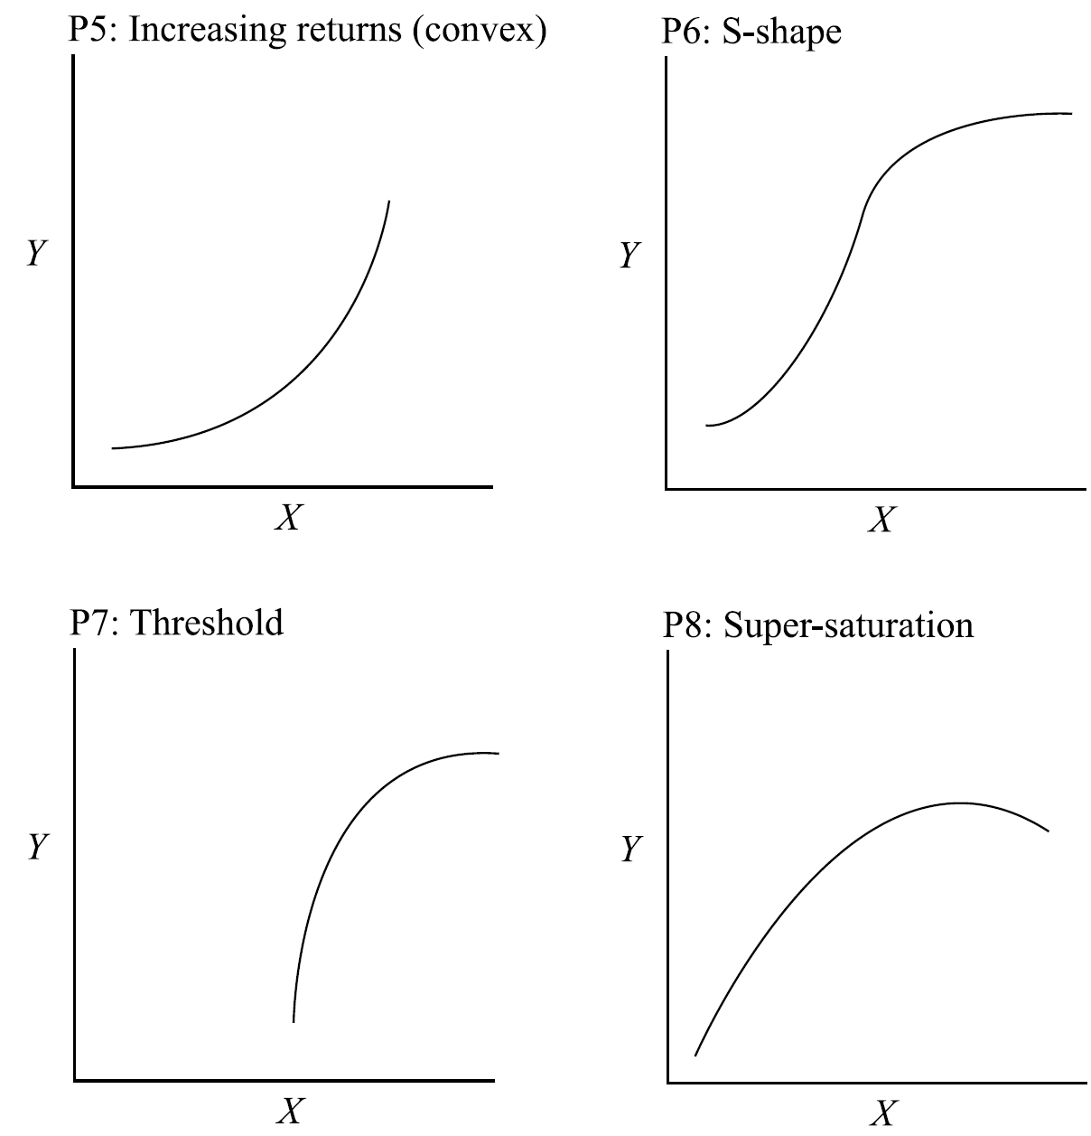
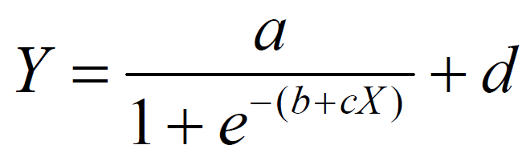




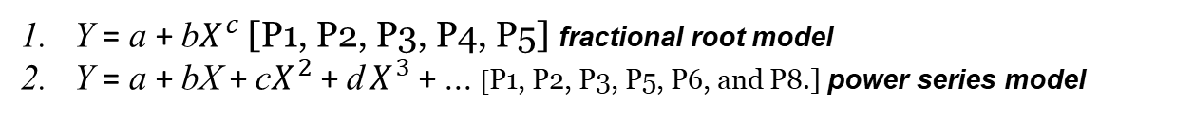
8 phenomena and Response Functions
ADBUDG Model
[P1, P3, P4, P6]
Y = a + b$X^{c}$[P1, P2, P3, P4, P5] fractional root model
Y = a + bX + c$X^{2}$+ d $X^{3}$+ ... [P1, P2, P3, P5, P6, and P8.] power series model
Exponential model
Y = a$e^{\text{bX}}$ where X > 0
Logistic model
linear model
Y = bX
linear model
Y = a + bX
Y = a + b ln X
Y = a(1− $e^{\text{bX}}$ ) + c
Y = a(1− $e^{\text{bX}}$ ) + c
Semilog model
Y = a + b ln X
Y = a$e^{\text{bX}}$ where X > 0

Slide 20
Response function calibration

Slide 21
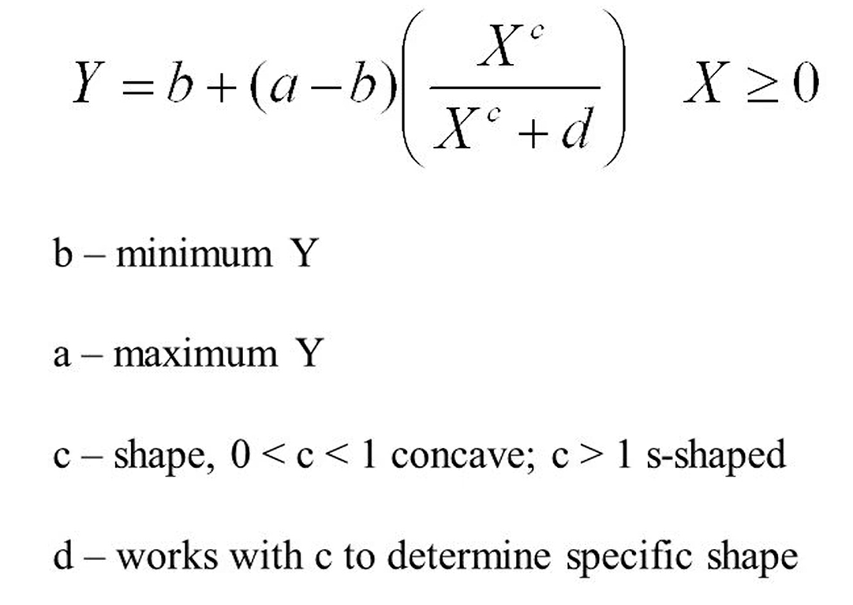
TV ads
Model used: adbudg
X: Effort (Advertising)
Y: Impact (Sales or Market Share)
competitive effort levels directed toward sales entity i (the
larger this value, the smaller the impact of the firm’s own sales effort on
sales).
competitive effort levels directed toward sales entity i (the
larger this value, the smaller the impact of the firm’s own sales effort on
sales).
d: Parameter of competitive effort levels directed toward sales (the larger this value, the smaller the impact of the firm’s own sales effort on sales).
See also Marketing Analytics: Data-Driven Techniques with Microsoft Excel (2014) https://apprize.best/microsoft/excel_4/33.html The whole book at https://apprize.best/microsoft/excel_4/

Slide 22
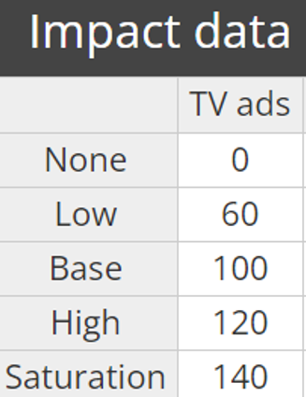
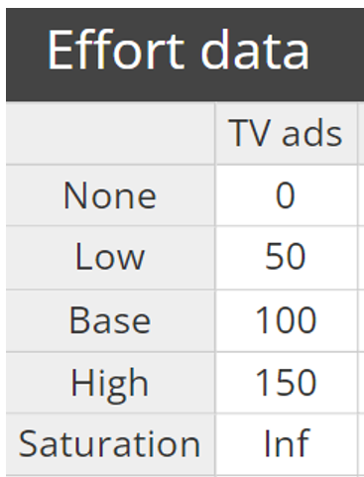
Model fit for TV ads
X
Y
 | Effort | Impact | Fit
None | 0.00 | 0 | 4.83
Low | 500.00 | 2100 | 2068.49
Base | 1000.00 | 3500 | 3503.26
High | 1500.00 | 4200 | 4104.91
Saturation | Saturation | 4900 | 4900.00
The values at Y column predicted by the model should be very close to the Impact column's values since the model coefficients are derived with the Effort and Impact Data.
Base
Scenario
Actual Data
3500 ⬅➔100
* TV ads Impact
1000.00 ⬅➔100
* TV ads Effort
100 etc. used in Effort and Impact data are relative numbers for calibration purose

Slide 23
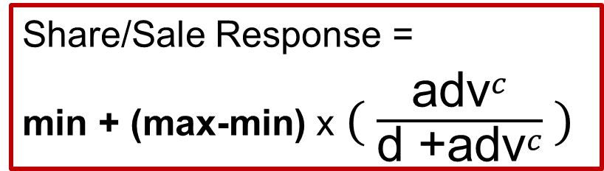
Parameters for TV ads
 | Ceiling | Floor | Slope | Intercept
Parameters | 4 900 | 4.830 | 1.781 | 87 959.825
 | b | a | c | d
Parameters for TV ads | Max | Min | c_shape | Competitiveness
 | Ceiling | Floor | Slope | Intercept
Parameters | 4900 | 4.830 | 1.781 | 87959.825
Estimated Sales in Excel based on AdBudg model using coefficients =
$$Min+(Max−Min)∗(POWER(C12,c_shape)/(Competitiveness+POWER(C12,c_shape)))$$
* In this case, C12 is the (advertising) Effort
Share/Sale Response =
min + (max-min) x $( \frac{{\text{adv}}^{c}}{\text{d}\text{ +}{\text{adv}}^{c}} )$

Slide 24
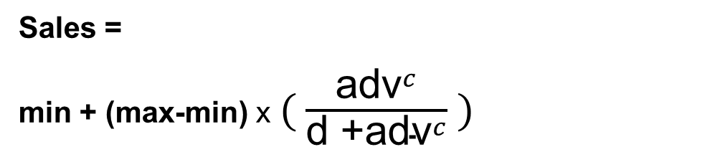
Model fit for TV ads
In Excel:
Fit (i.e., Sales) =Min+(Max-Min)*(POWER(C12,c_shape)/(Competitiveness+POWER(C12,c_shape)))
C12 is the Effort
X
Y
 | Effort | Impact | Fit
None | 0.00 | 0 | 4.83
Low | 500.00 | 2100 | 2068.49
Base | 1000.00 | 3500 | 3503.26
High | 1500.00 | 4200 | 4104.91
Saturation | Saturation | 4900 | 4900.00
Sales =
min + (max-min) x $( \frac{{\text{adv}}^{c}}{\text{d}\text{ +}{\text{adv}}^{c}} )$
Base
Scenario
➔
No need to use model to predict
This column is calculated based on the model using the coefficients of parameters inferred based on input data

Slide 25
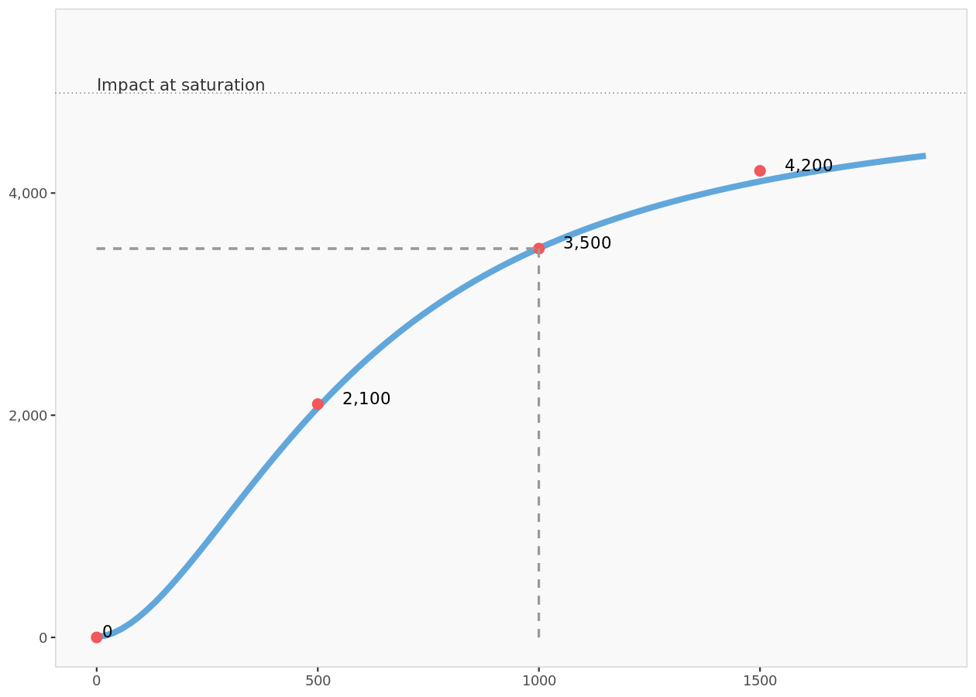

Model fit for TV ads
Max min c d
 | Ceiling | Floor | Slope | Intercept
Parameters | 4 900 | 4.830 | 1.781 | 87 959.825
Sales = min + (max-min) x $( \frac{{\text{adv}}^{c}}{\text{d}\text{ +}{\text{adv}}^{c}} )$

Slide 26
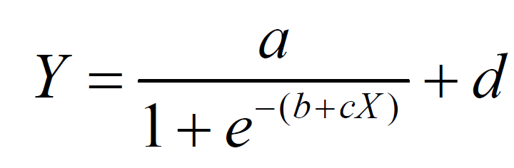
Print ads
Model used: logistic
This model has a saturation level at a+d and has a region of increasing returns followed by decreasing return to scale;
it is symmetrical around d+a/2.

Slide 27
Parameters for Print ads
 | a | d | c | b
 | *Ceiling | Floor | Slope | Intercept
Parameters | 1 600 | 0.000 | 0.012 | -2.968
* A is not really the ceiling ➔ a + d is the real ceiling at the saturation level
Y=a/(1+EXP(-(b+c*X)))+d

Slide 28
Model fit for Print ads
 | Effort | Impact | Fit
None | 0.00 | 0 | 78.2
Low | 125.00 | 320 | 295.6
Base | 250.00 | 800 | 799.5
High | 375.00 | 1 280 | 1303.9
Saturation | Saturation | 1 600 | 1600.0

Slide 29
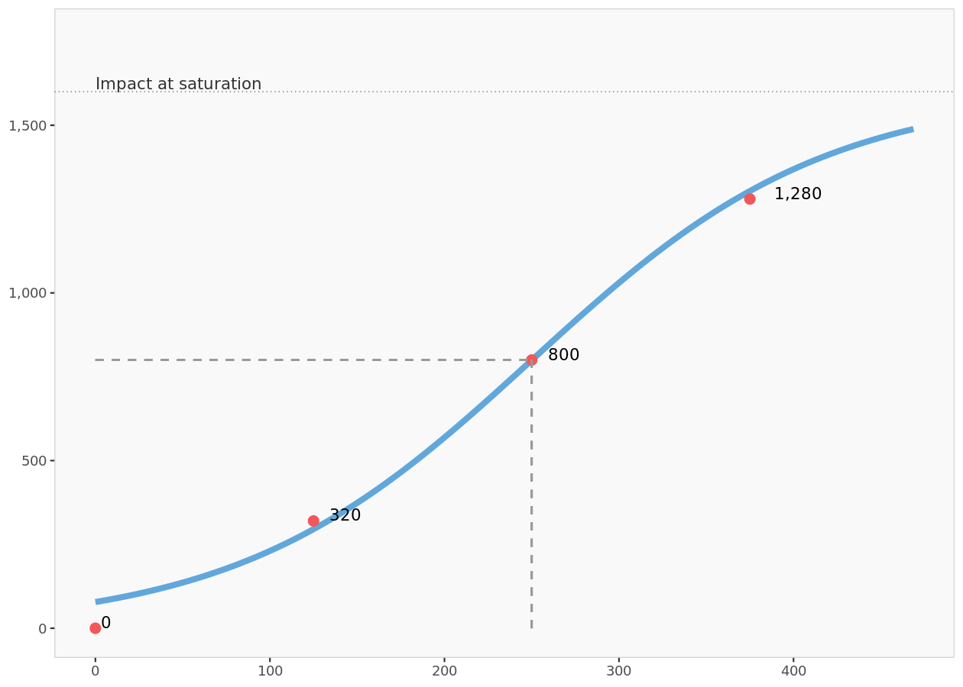
Model fit for Print ads

Slide 30
Radio ads
Model used: adbudg

Slide 31
Parameters for Radio ads
 | Ceiling | Floor | Slope | Intercept
Parameters | 350 | 0.000 | 3.797 | 15756945.311

Slide 32
Model fit for Radio ads
 | Effort | Impact | Fit
None | 0.00 | 0.0 | 0.0
Low | 50.00 | 50.0 | 53.2
Base | 100.00 | 250.0 | 249.8
High | 150.00 | 312.5 | 322.3
Saturation | Saturation | 350.0 | 350.0

Slide 33
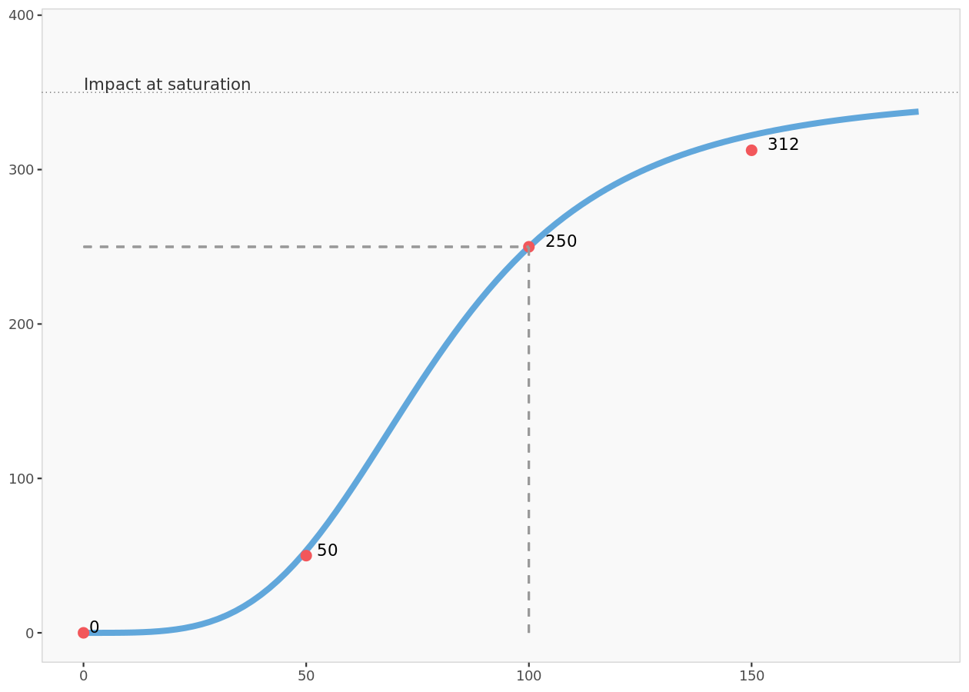
Model fit for Radio ads

Slide 34
Direct marketing
Model used: logistic

Slide 35
Parameters for Direct marketing
 | Ceiling | Floor | Slope | Intercept
Parameters | 11200 | 213.744 | 0.002 | -3.845

Slide 36
Model fit for Direct marketing
 | Effort | Impact | Fit
None | 0.00 | 0 | 444
Low | 750.00 | 2 000 | 1 270
Base | 1 500.00 | 4 000 | 4 014
High | 2 250.00 | 8 400 | 8 173
Saturation | Saturation | 11 200 | 11 200

Slide 37
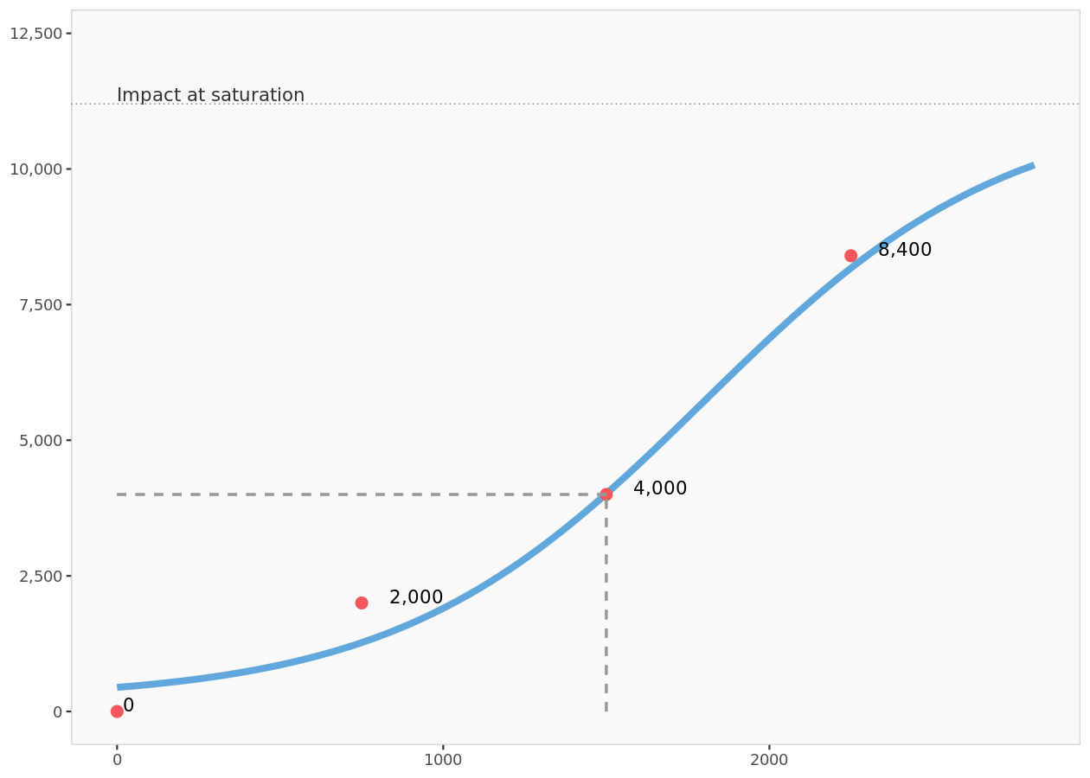
Model fit for Direct marketing

Slide 38
Internet
Model used: logistic

Slide 39
Parameters for Internet
 | Ceiling | Floor | Slope | Intercept
Parameters | 840 | 0.000 | 0.013 | -4.133

Slide 40
Model fit for Internet
 | Effort | Impact | Fit
None | 0.00 | 0.0 | 13.3
Low | 150.00 | 80.0 | 90.4
Base | 300.00 | 400.0 | 399.7
High | 450.00 | 720.0 | 732.7
Saturation | Saturation | 840.0 | 840.0

Slide 41
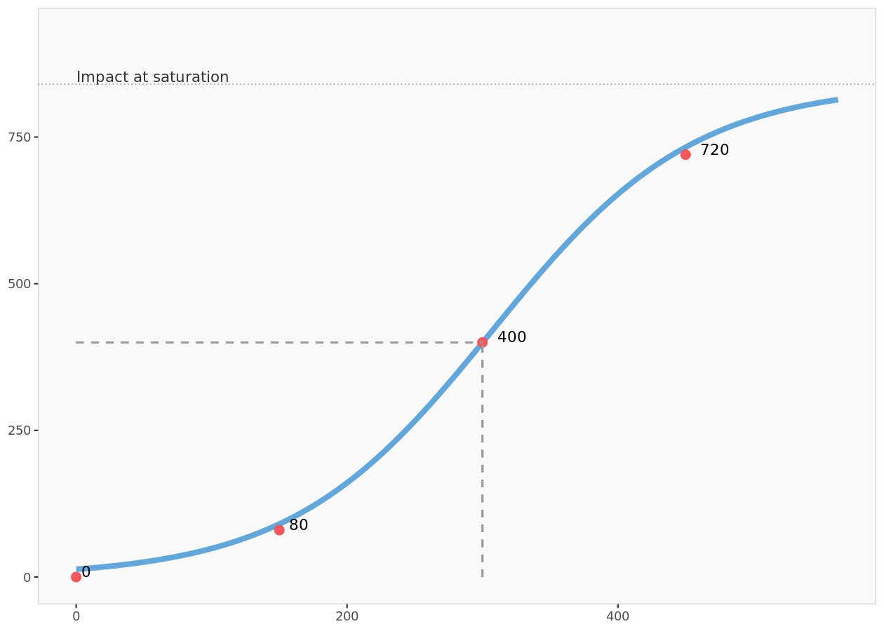
Model fit for Internet

Slide 42
Base scenario

Slide 43
Base scenario table
Margin really mean revenue!!!
 | Current budget ($K) | Current revenues ($K) | Cost per effort unit | Margin per output unit | Cost of effort | Gross margin | Net margin
TV ads | 1 000.00 | 3 500 | 1 000.00 | 1 000.00 | 1 000 000 | 3 500 000 | 2 500 000
Print ads | 250.00 | 800 | 1 000.00 | 1 000.00 | 250 000 | 800 000 | 550 000
Radio ads | 100.00 | 250 | 1 000.00 | 1 000.00 | 100 000 | 250 000 | 150 000
Direct marketing | 1 500.00 | 4 000 | 1 000.00 | 1 000.00 | 1 500 000 | 4 000 000 | 2 500 000
Internet | 300.00 | 400 | 1 000.00 | 1 000.00 | 300 000 | 400 000 | 100 000
Total | 3 150.00 | 8 950 |  |  | 3 150 000 | 8 950 000 | 5 800 000

Slide 44
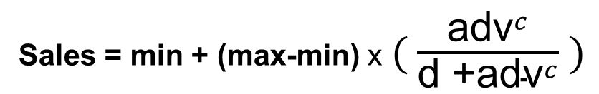
Calculating Cost, Revenue, and Profit
 | TV ads | TV Ad with Formula | Cell Formula
Current budget ($K) | 1000.00 | 1,000 | M6
Current revenues ($K) | 3500 | 3,503 | M7
Cost per effort unit | 1000.00 | 1,000 | M8
Margin (Revenue) per output unit | 1000.00 | 1,000 | M9
Cost of effort | 1000000 | 1,000,000 | M10=M6*M8
Gross margin (Revenue) | 3500000 | 3,503,260 | M11=M7*M9
Net margin (Profit) | 2500000 | 2,503,260 | M12=M11-M10
M7 ➔ Revenue(Sales)
=Min+(Max-Min) * (POWER(M6,c_shape)/ (Competitiveness+POWER(M6,c_shape)))
Sales = min + (max-min) x $( \frac{{\text{adv}}^{c}}{\text{d}\text{ +}{\text{adv}}^{c}} )$
To be optimized
 | b | a | c | d
Parameters for TV ads | Max | Min | c_shape | Competitiveness
 | Ceiling | Floor | Slope | Intercept
Parameters | 4900 | 4.830 | 1.781 | 87959.825

Slide 45
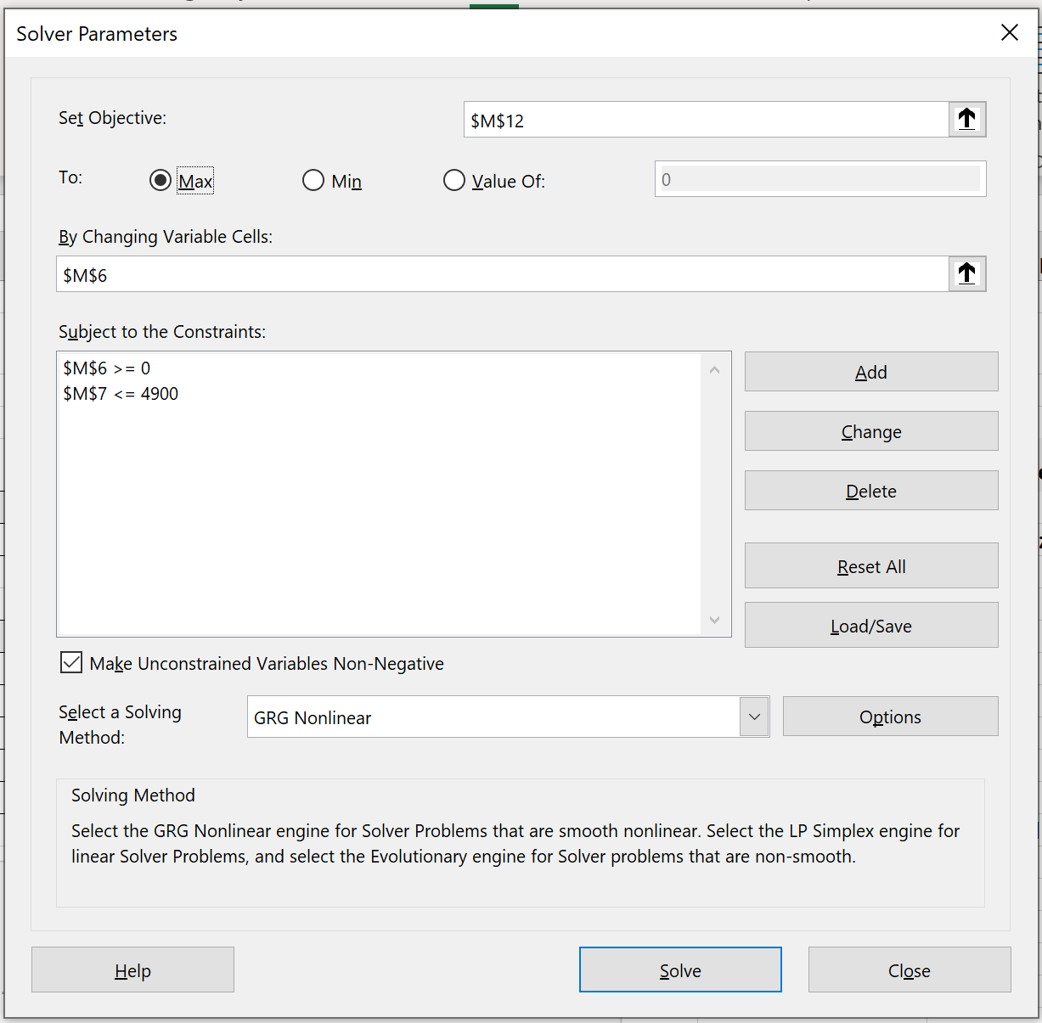
Use Excel's Solver To Find Budget to Be Allocated to Optimize (Maximum) Profit
Why not set Gross margin as Objective?
Net margin
According to the calibrated response function
Budget ($K)
 | TV ads Base Scenario | TV Ad Optimized
Budget ($K) | 1000.00 | 1,345
Revenues ($K) | 3500 | 3,967
Cost per effort unit | 1000.00 | 1,000
Margin per output unit | 1000.00 | 1,000
Cost of effort | 1000000 | 1,345,022
Gross margin | 3500000 | 3,966,957
Net margin | 2500000 | 2,621,935

Slide 46
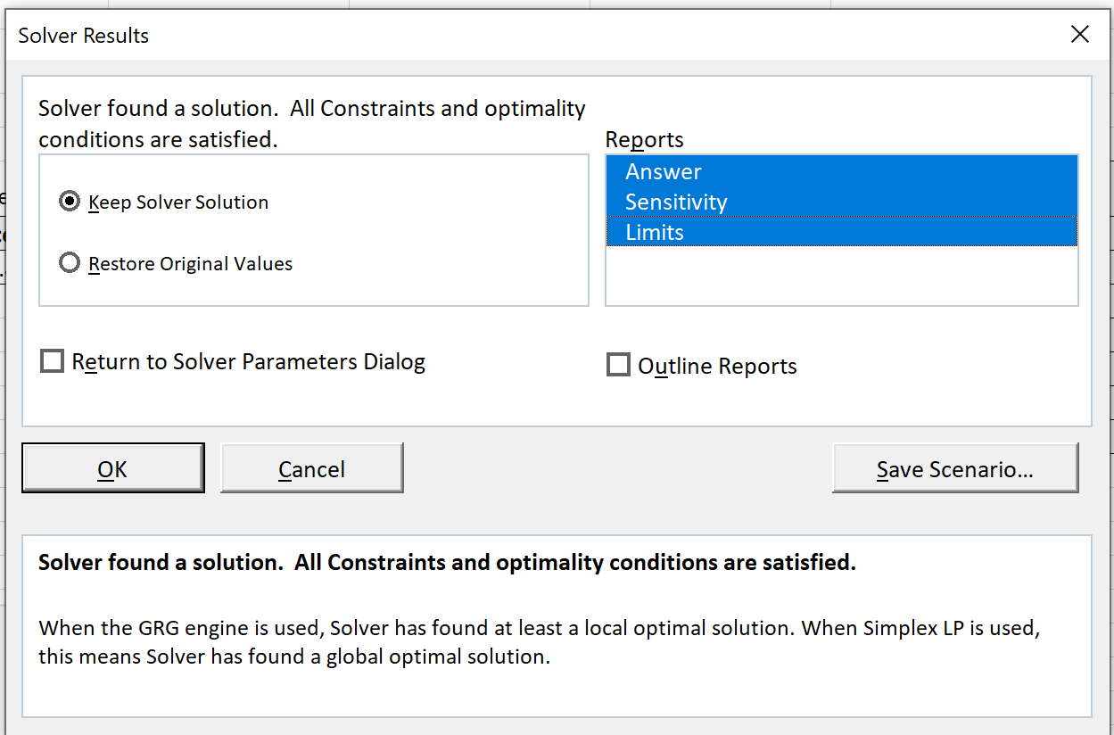

Slide 47
Unconstrained optimization

Slide 48
Comparison of effort in unconstrained optimization (of Profit/Net Margin)
 | Cost ($K) | Cost($K) | % change in effort
 | Base effort | Optimized effort | % change in effort
TV ads | 1 000 | 1 345 | 34.5%
Print ads | 250 | 488 | 95.4%
Radio ads | 100 | 135 | 34.7%
Direct marketing | 1 500 | 3 231 | 115.4%
Internet | 300 | 472 | 57.4%
Total | 3 150 | 5 672 | 80.1%
 | Optimal TV Ad for maximum Net Margin
Current budget ($K) | 1,345
Current revenues ($K) | 3,967
Cost per effort unit | 1,000
Margin per output unit | 1,000
Cost of effort | 1,345,022
Gross margin | 3,966,957
Net margin | 2,621,935

Slide 49
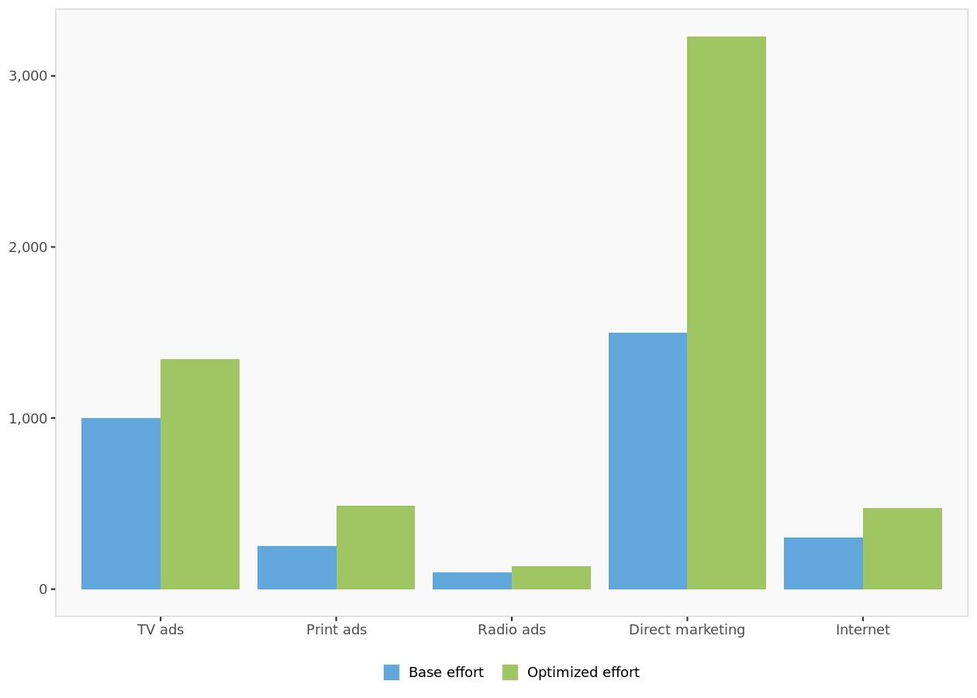
Comparison of effort in unconstrained optimization

Slide 50
Comparison of net margin in unconstrained optimization
 | Base Profit | Optimized Profit | % change in Profit
 | Base net margin | Optimized net margin | % change in margin
TV ads | 2 500 000 | 2 621 935 | 4.9%
Print ads | 550 000 | 1 022 282 | 85.9%
Radio ads | 150 000 | 175 201 | 16.8%
Direct marketing | 2 500 000 | 7 479 220 | 199.2%
Internet | 100 000 | 285 510 | 185.5%
Total | 5 800 000 | 11 584 149 | 99.7%
 | Optimal TV Ad for maximum Net Margin
Current budget ($K) | 1,345
Current revenues ($K) | 3,967
Cost per effort unit | 1,000
Margin per output unit | 1,000
Cost of effort | 1,345,022
Gross margin | 3,966,957
Net margin | 2,621,935

Slide 51
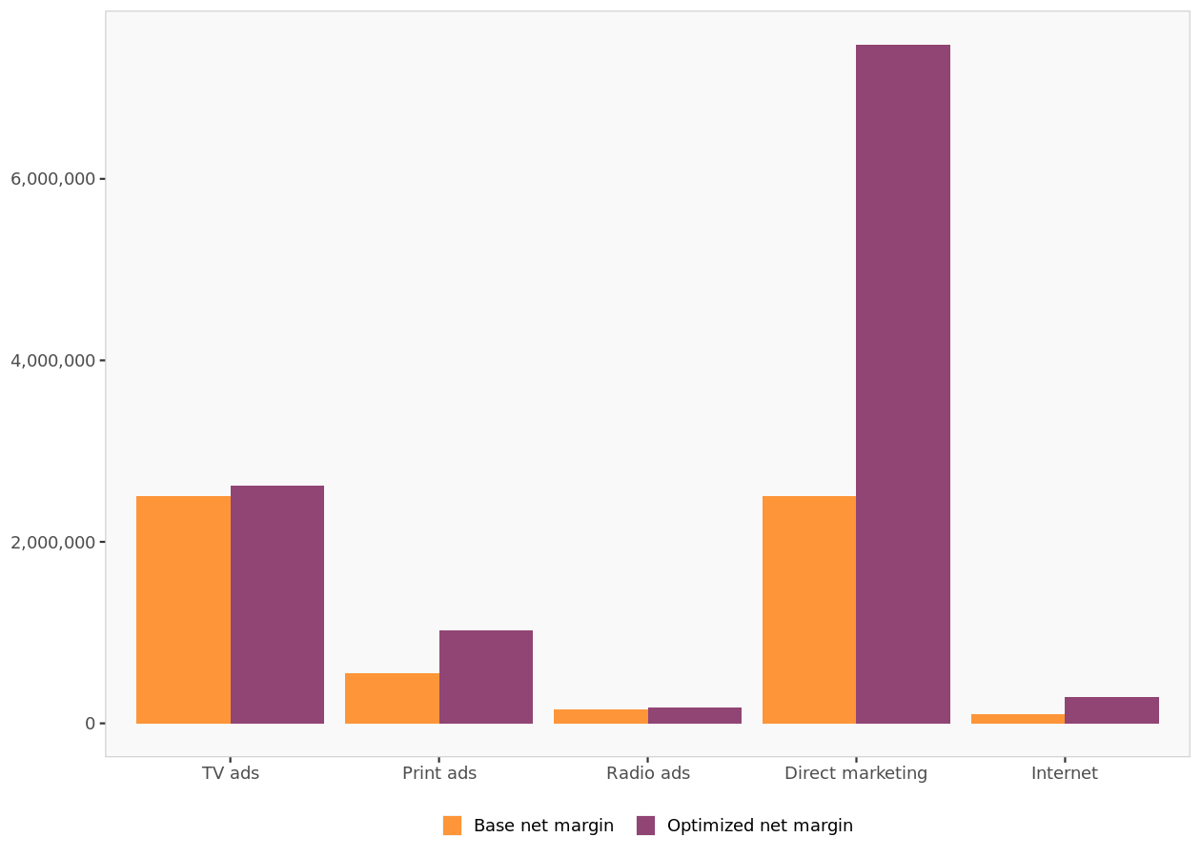
Comparison of net margin in unconstrained optimization

Slide 52
Constrained optimization

Slide 53
Table of constraints (of Efforts)
 | Global constraints | TV ads | Print ads | Radio ads | Direct marketing | Internet
Minimum | 0 | 750 | 0 | 0 | 0 | 0
Maximum | 4000 | NA | NA | NA | NA | 500
Apply these constraints to the optimization problem. ➔ Optimize the profit (net margin) !

Slide 54
Comparison of effort in constrained optimization
 | Base effort | Optimized effort | % change in effort
TV ads | 1 000 | 842.712 ??? | -15.7%
Print ads | 250 | 399.431 | 59.8%
Radio ads | 100 | 0.001 | -100.0%
Direct marketing | 1 500 | 2 760.648 | 84.0%
Internet | 300 | 0.001 | -100.0%
Total | 3 150 | 4 002.793 | 27.1%

Slide 55
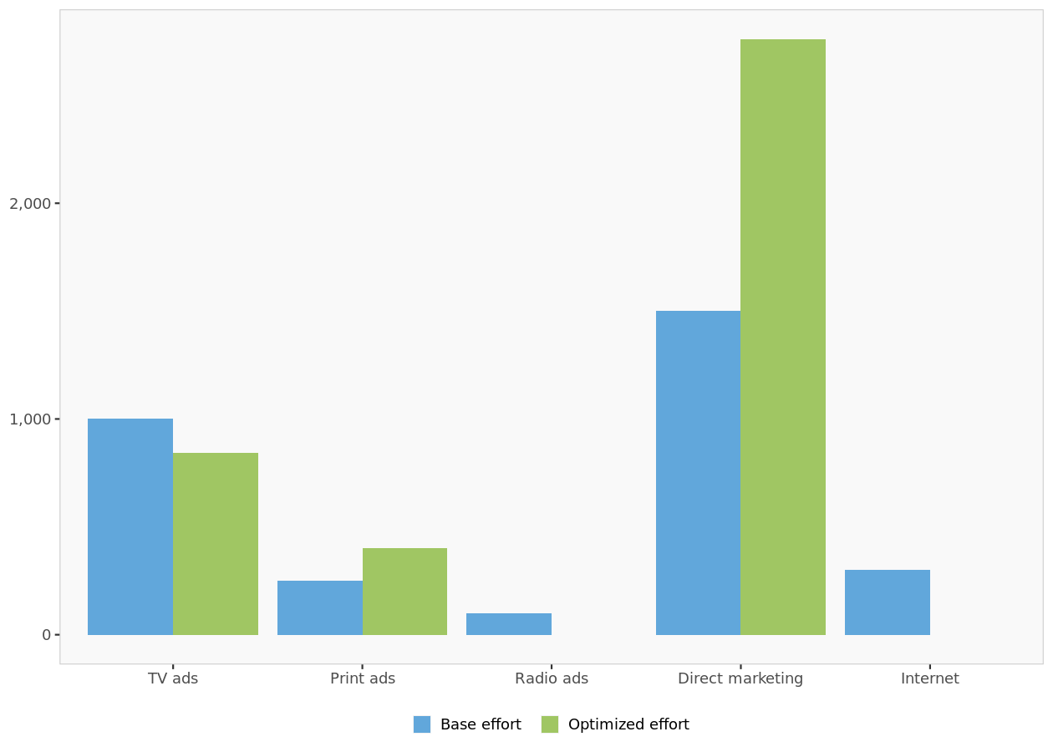
Comparison of effort in constrained optimization

Slide 56
Comparison of net margin in constrained optimization
 | Base net margin | Optimized net margin | % change in margin
TV ads | 2 500 000 | 2 337 680.275 | -6.5%
Print ads | 550 000 | 968 150.424 | 76.0%
Radio ads | 150 000 | -1.000 | -100.0%
Direct marketing | 2 500 000 | 7 196 265.976 | 187.9%
Internet | 100 000 | 13 249.576 | -86.8%
Total | 5 800 000 | 10 515 345.252 | 81.3%

Slide 57
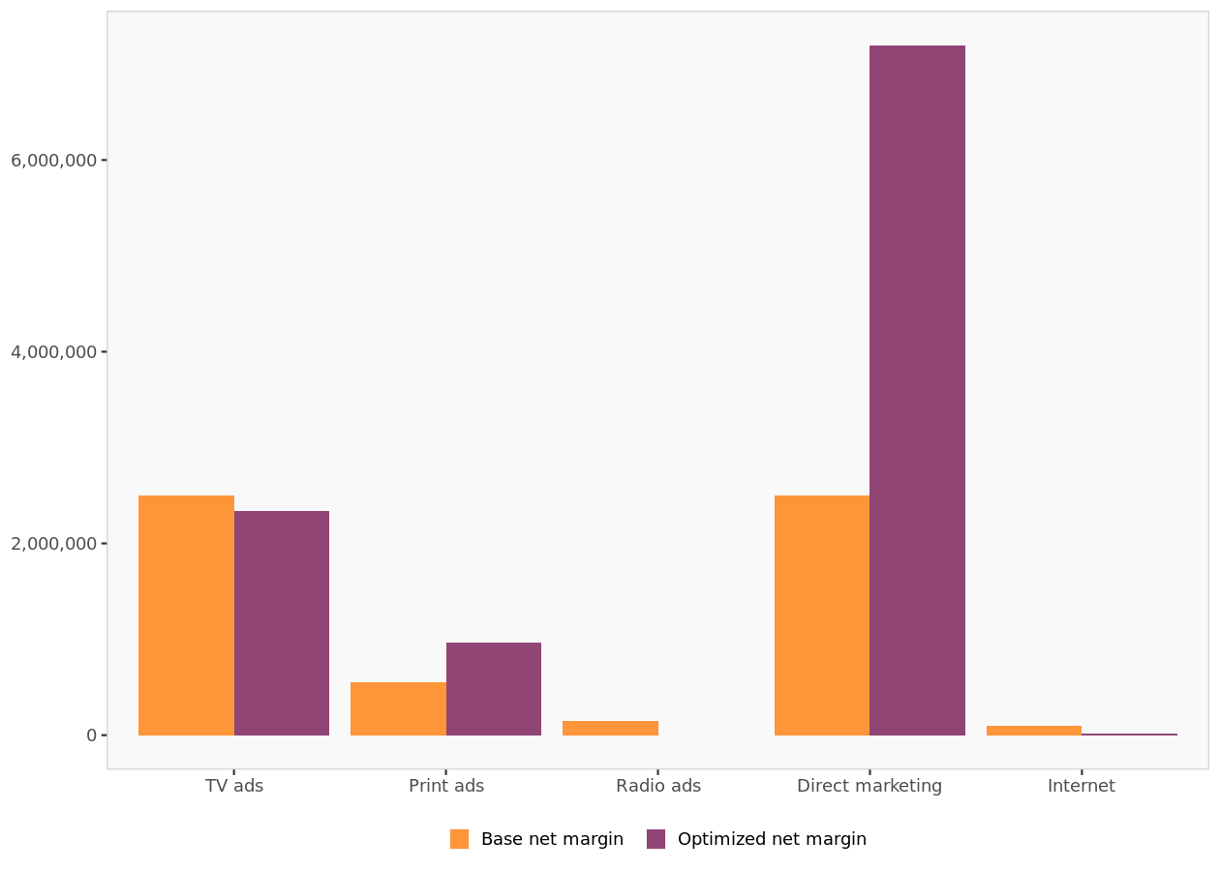
Comparison of net margin in constrained optimization

Slide 58
Opportunity costs
 | Global constraints | TV ads | Print ads | Radio ads | Direct marketing | Internet
Minimum |  | 0 | 0 | 0 | 0 | 0
Maximum | 2348 |  |  |  |  | 0
** Change in net margin by relaxing (decreasing) a lower constraint by 1 unit, or relaxing (increasing) an upper constraint by 1 unit. An empty cell means no constraint was set. A value of 0 means that a constraint was set but not reached, and net margin would not be improved by relaxing it.
 | Global constraints | TV ads | Print ads | Radio ads | Direct marketing | Internet
Minimum | 0 | 750 | 0 | 0 | 0 | 0
Maximum | 4000 | NA | NA | NA | NA | 500
 | Base effort | Optimized effort | Base Profit | Optimized Profit
net margin in unconstrained optimization | 3,150.00 | 5,672.00 | 5,800,000.00 | 11,584,149.00
Change of Effort | 2,522.00
Change of Profit | 5,784,149.00
Change of Profit / Change of Effort | 2,293.48
⬅ My calculation

Slide 59
Comparison of scenarios

Slide 60
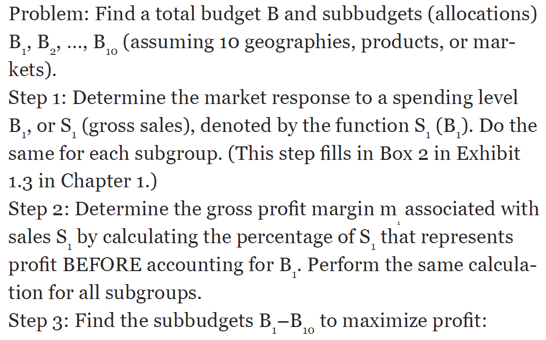
This response model approach uses the following general structure

Slide 61
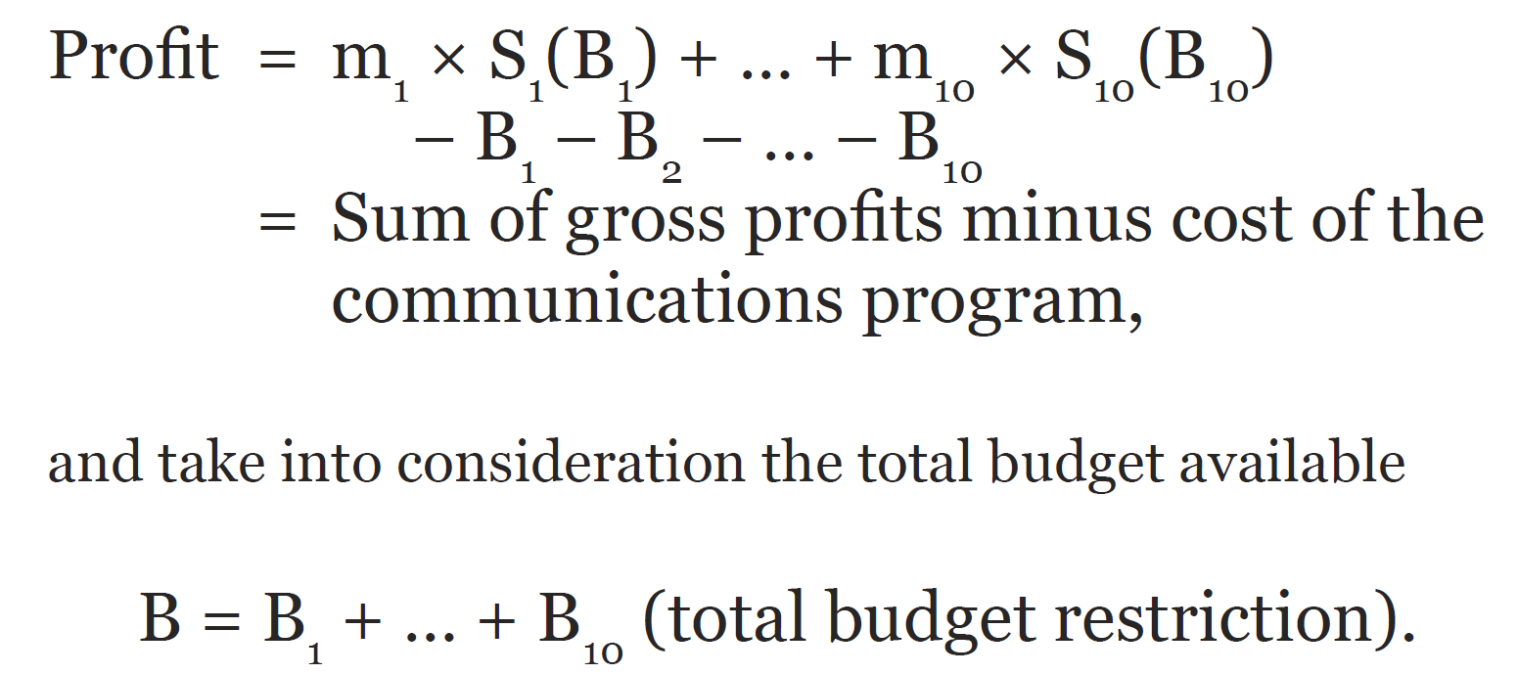




Global Constraint and Optimization

Slide 62
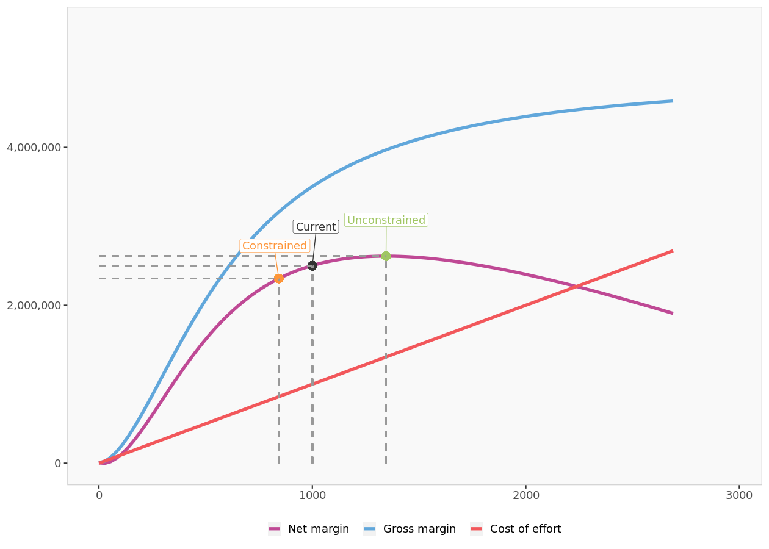
TV ads: scenarios
$
Impact
Gross Margin
Cost of effort
Net Margin
$
Effort

Slide 63
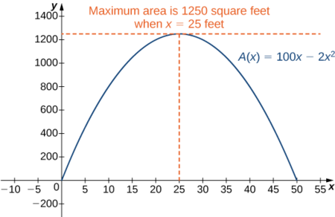
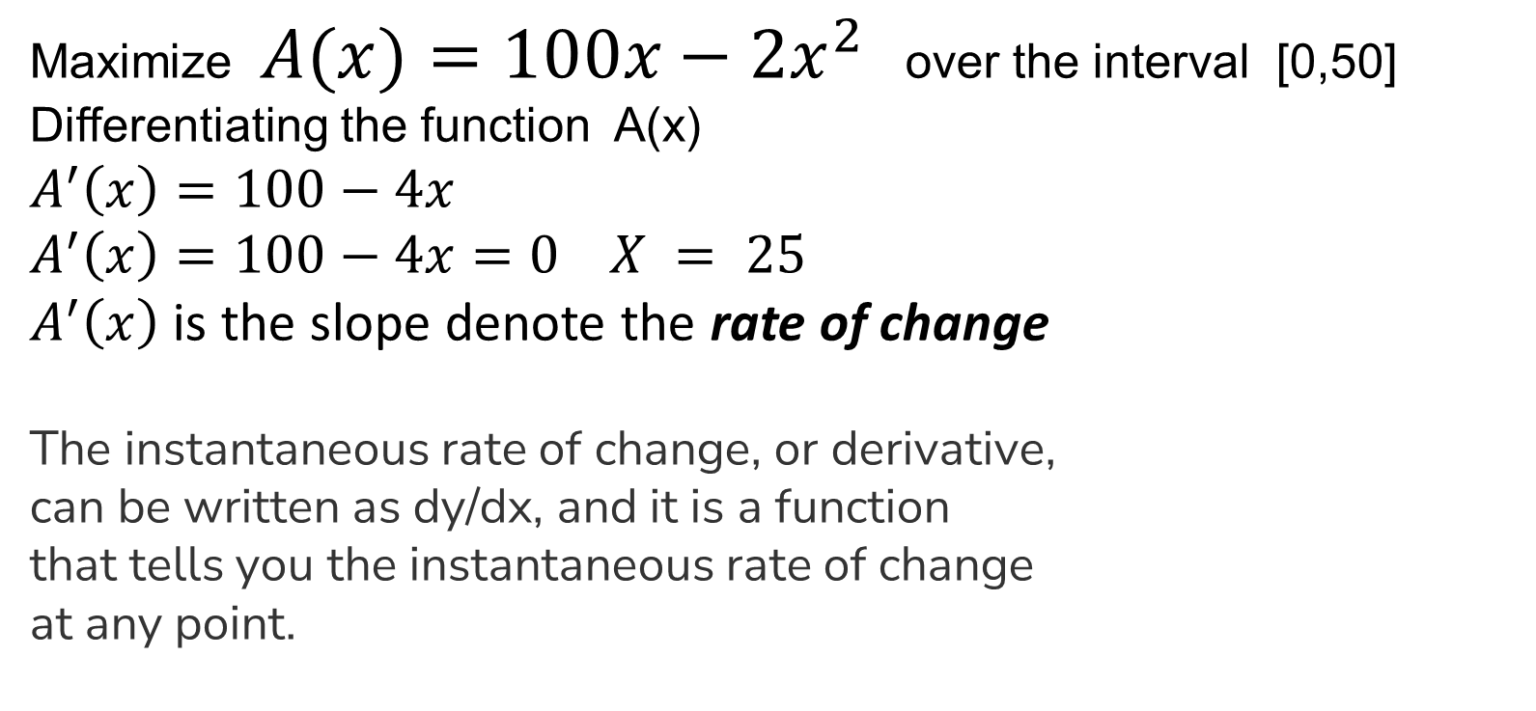
Optimization
Maximize $A(x)=100x−2x^{2}$ over the interval [0,50]
Differentiating the function A(x)
$$A^{′}\left(x\right)=100−4x$$
$A^{′}\left(x\right)=100−4x$ $=0 X = 25$
$A^{′}\left(x\right)$ is the slope denote the rate of change
The instantaneous rate of change, or derivative,
can be written as dy/dx, and it is a function
that tells you the instantaneous rate of change
at any point.
https://math.libretexts.org/Bookshelves/Calculus/Map%3A_Calculus__Early_Transcendentals_(Stewart)/04%3A_Applications_of_Differentiation/4.07%3A_Optimization_Problems
Notes:
https://math.libretexts.org/Bookshelves/Calculus/Map%3A_Calculus__Early_Transcendentals_(Stewart)/04%3A_Applications_of_Differentiation/4.07%3A_Optimization_Problems
https://socratic.org/questions/how-does-rate-of-change-relate-to-slope

Slide 64
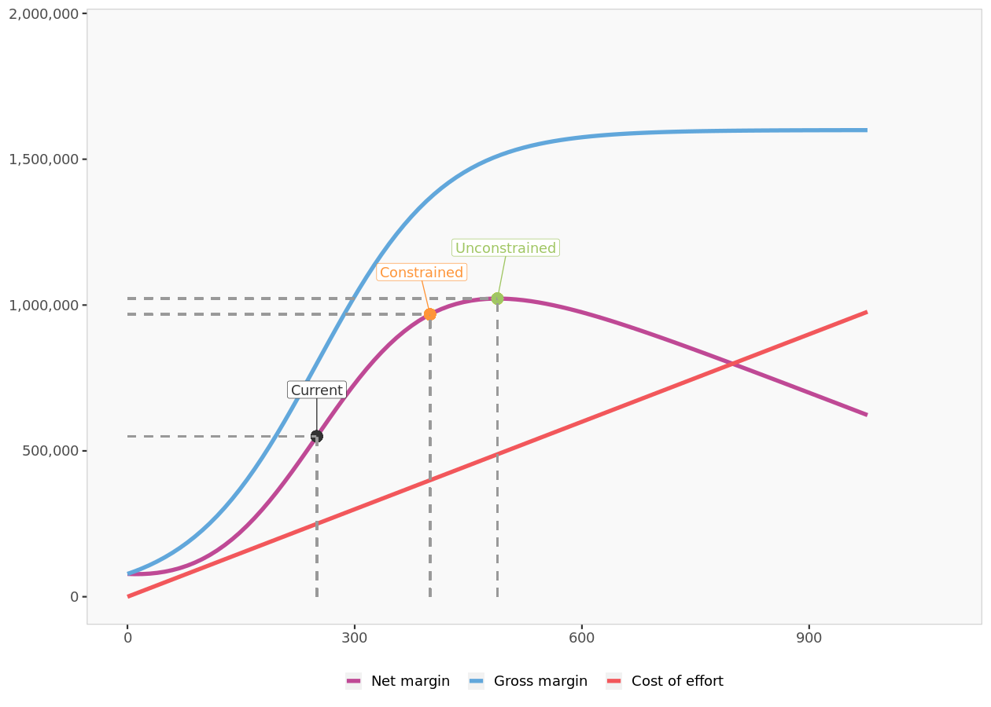
Print ads: scenarios

Slide 65
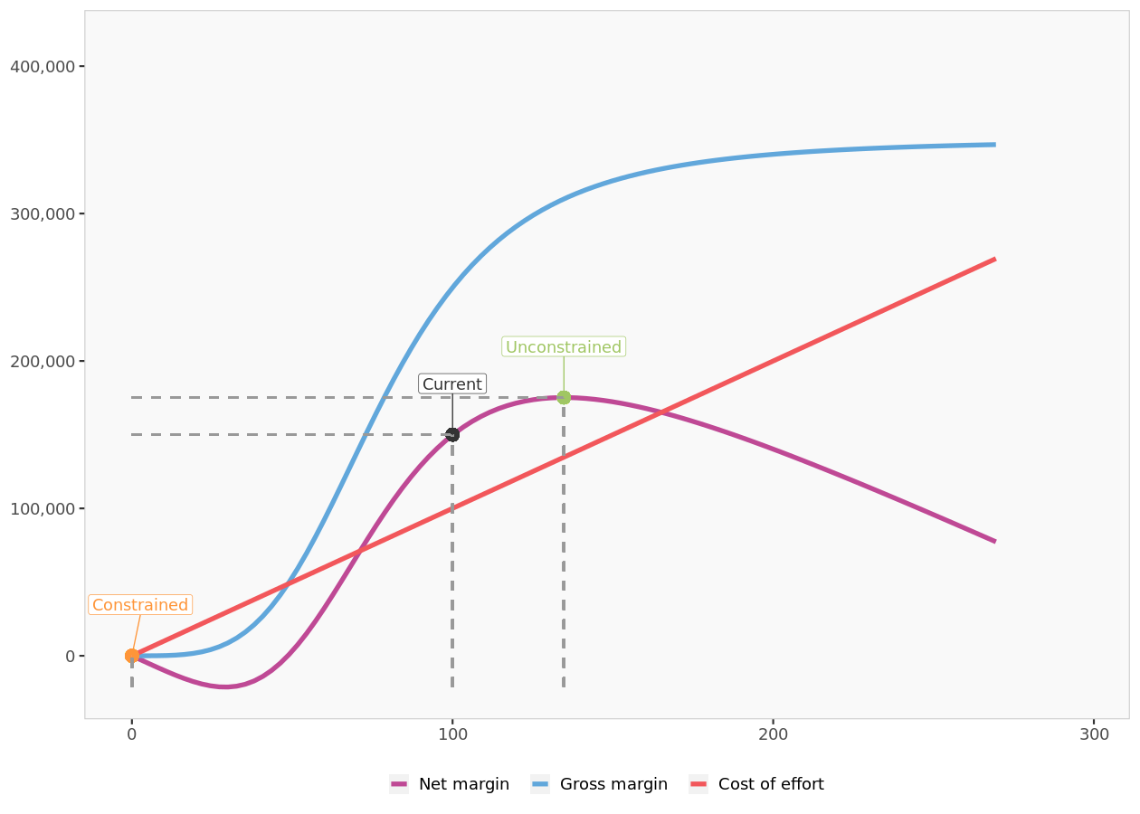
Radio ads: scenarios

Slide 66
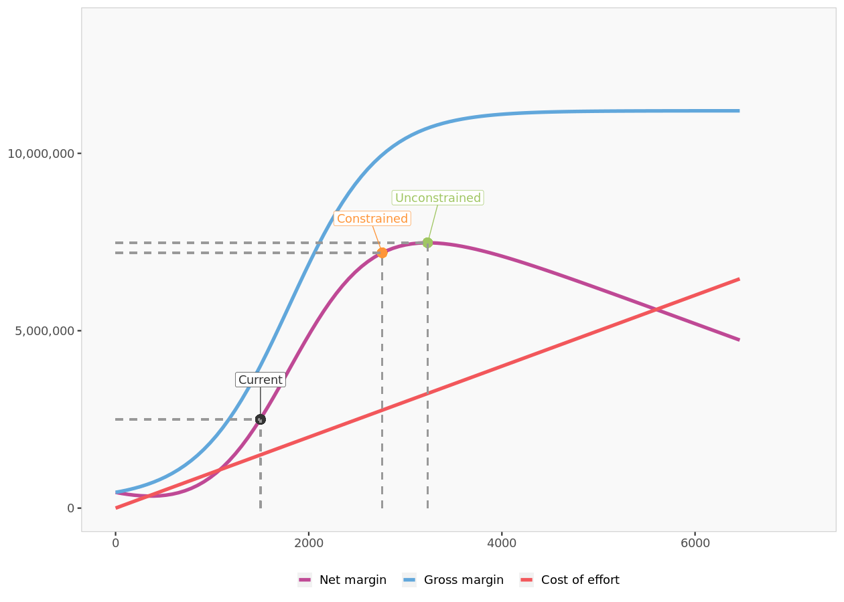
Direct marketing: scenarios

Slide 67

Internet: scenarios

Slide 68

Comparison of scenarios

Slide 69
Sensitivity analysis

Slide 70
Sensitivity analysis
 | Total effort | Net margin
No effort | 0 | 540 127
-90% effort | 567 | 480 357
-80% effort | 1 134 | 1 317 719
-70% effort | 1 702 | 3 542 992
-60% effort | 2 269 | 6 090 716
-50% effort | 2 836 | 7 890 443
-40% effort | 3 403 | 9 333 916
-30% effort | 3 970 | 10 474 198
-20% effort | 4 537 | 10 958 740
-10% effort | 5 105 | 11 450 158
Recommended | 5 672 | 11 584 149
+10% effort | 6 239 | 11 484 570
+20% effort | 6 806 | 11 229 692
+30% effort | 7 373 | 10 877 419

Slide 71

Sensitivity analysis
 | Total effort | Net margin
Recommended | 5 672 | 11 584 149
Net margin
Unconstrained optimization
Constrained Optimization
Base Scenario
Total effort

